Slide 1
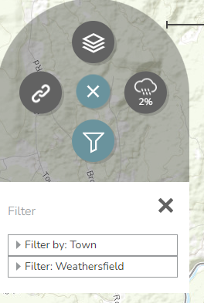
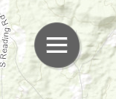
VTrans Transportation Flood Resilience Planning Tool (TRPT)
Link to online tool: https://roadfloodresilience.vermont.gov/#/map
Additional info: https://vtrans.vermont.gov/planning/transportation-resilience
Road segment resilience is rated Low, Medium, or High
Rating is based on Criticality and Vulnerability
Criticality: impact on local and regional travel, importance of a road for local use and for critical facility access (i.e. hospitals)
Vulnerability: damage impact from flood (i.e. inundation, erosion, or deposition) on roads, bridges, and culverts
Click Here
Then apply Filter to view Weathersfield roads

Slide 2
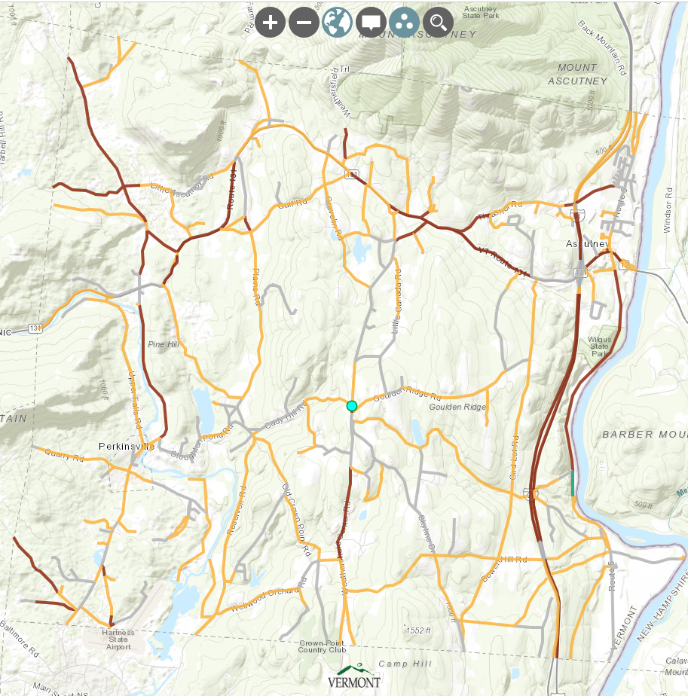
VTrans Transportation Flood Resilience Planning Tool (TRPT)
ROADS
*Based on 100-year flood. Settings can be adjusted to show 50-year and 10-year scenarios.

Slide 3
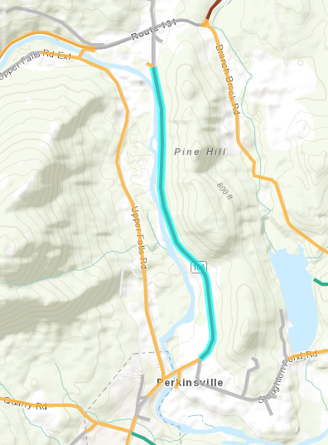
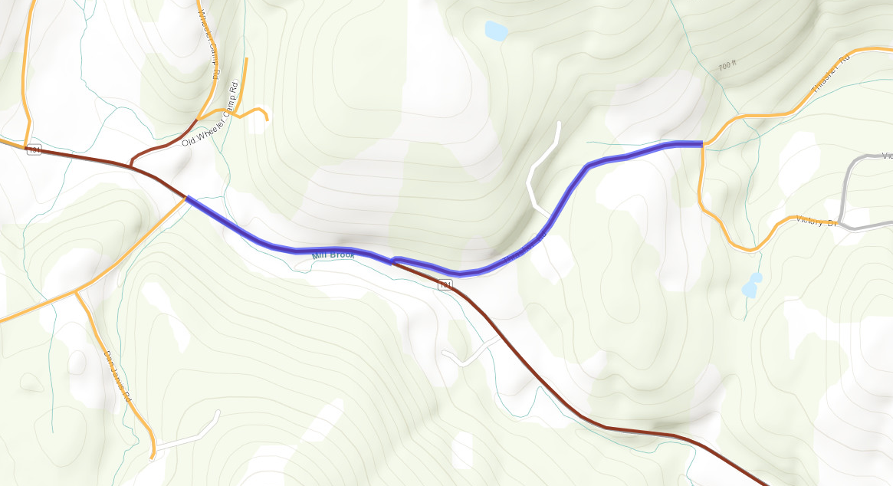
Road Segments with High Criticality and High Vulnerability:
VTrans Transportation Flood Resilience Planning Tool (TRPT)
Rt-106
Rt-131 & Thrasher Rd

Slide 4
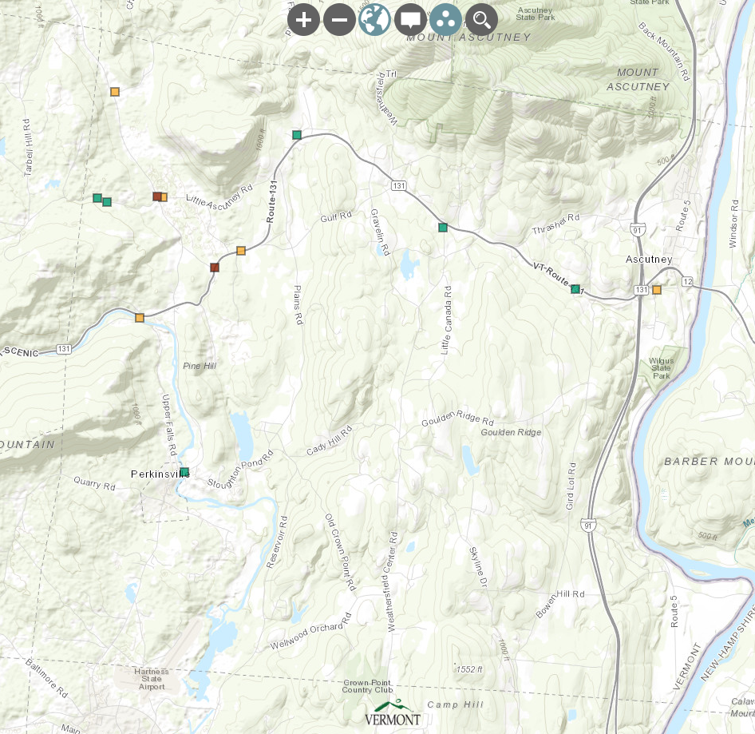
VTrans Transportation Flood Resilience Planning Tool (TRPT)
BRIDGES
*Based on 100-year flood. Settings can be adjusted to show 50-year and 10-year scenarios.

Slide 5
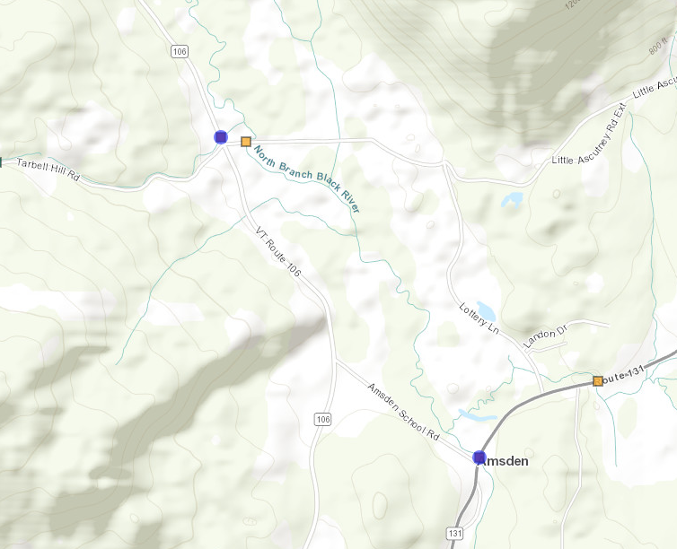
Bridges with High Criticality and High Vulnerability:
VTrans Transportation Flood Resilience Planning Tool (TRPT)
On Rt-106 (? Tributary ?) and Rt-131 (North Branch Black River)

Slide 6
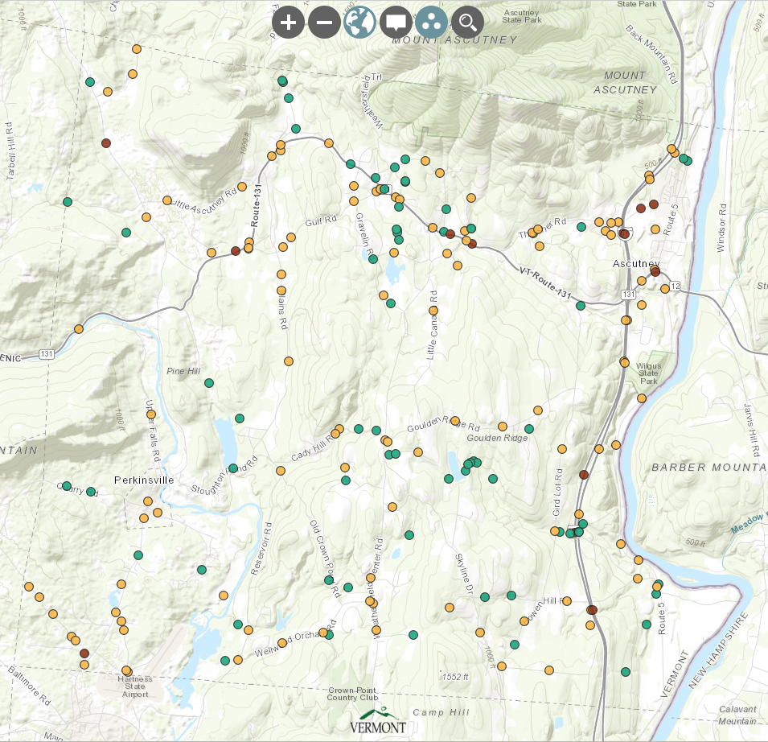
VTrans Transportation Flood Resilience Planning Tool (TRPT)
CULVERTS
*Based on 100-year flood. Settings can be adjusted to show 50-year and 10-year scenarios.

Slide 7
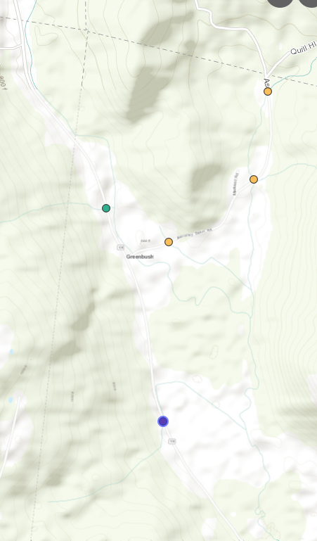
Culvert with High Criticality and High Vulnerability:
VTrans Transportation Flood Resilience Planning Tool (TRPT)
On Rt-106

Slide 8
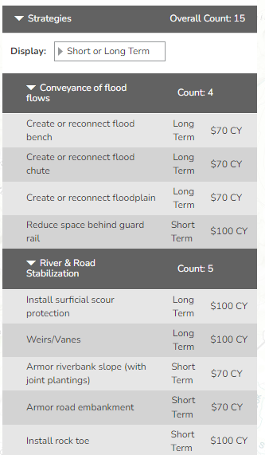
VTrans Transportation Flood Resilience Planning Tool (TRPT)
For each road/bridge/culvert, the tool offers strategies for improving the structure; for example:

