Slide 1
Individual Exercise: Hazard Events Assessment

Slide 2
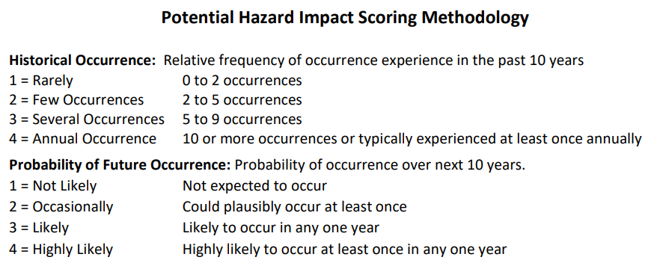
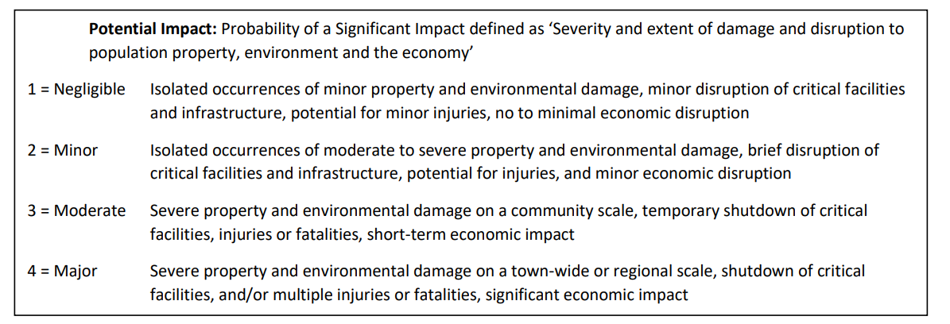

Slide 3
Name: _______________________ Email: ____________________________ Please send a scan of completed worksheet to MCORDERO@MARCVT.ORG
Hazard Impacts | Historical Occurrence | Probability of Future Occurrence | Potential Impact |  |  |  |  | Score
 |  |  | Infrastructure | Life | Economy | Environment | Average
Fluvial Erosion
Inundation Flooding
Ice
Snow
Wind
Extreme Heat
Extreme Cold
More on next page→

Slide 4
Hazard Impacts | Historical Occurrence | Probability of Future Occurrence | Potential Impact |  |  |  |  | Score
 |  |  | Infrastructure | Life | Economy | Environment | Average
Drought
Landslides (Slope Failure)
Wildfire
Earthquake
Invasive Species
Infectious Disease Outbreak
Hail

