Slide 1
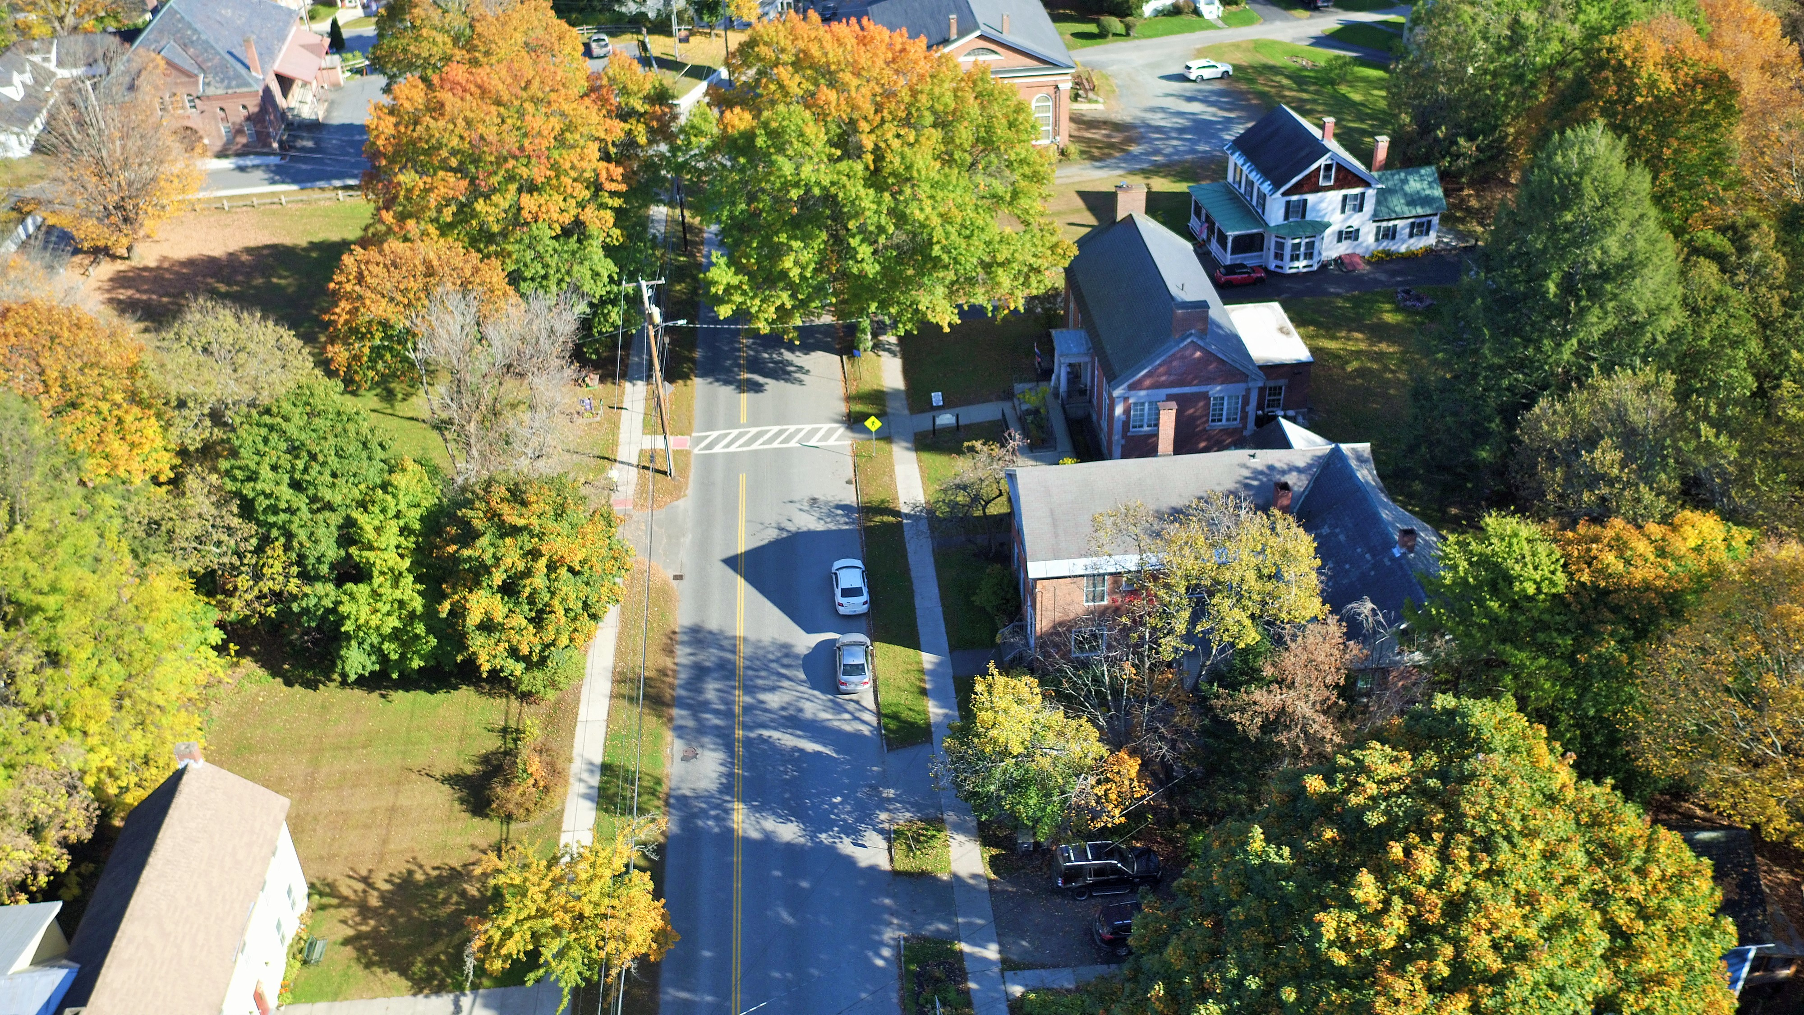

Development Review
For Bicycle and Pedestrian Accommodations
Photo by Braxton Freeman
June 23, 2020

Slide 2
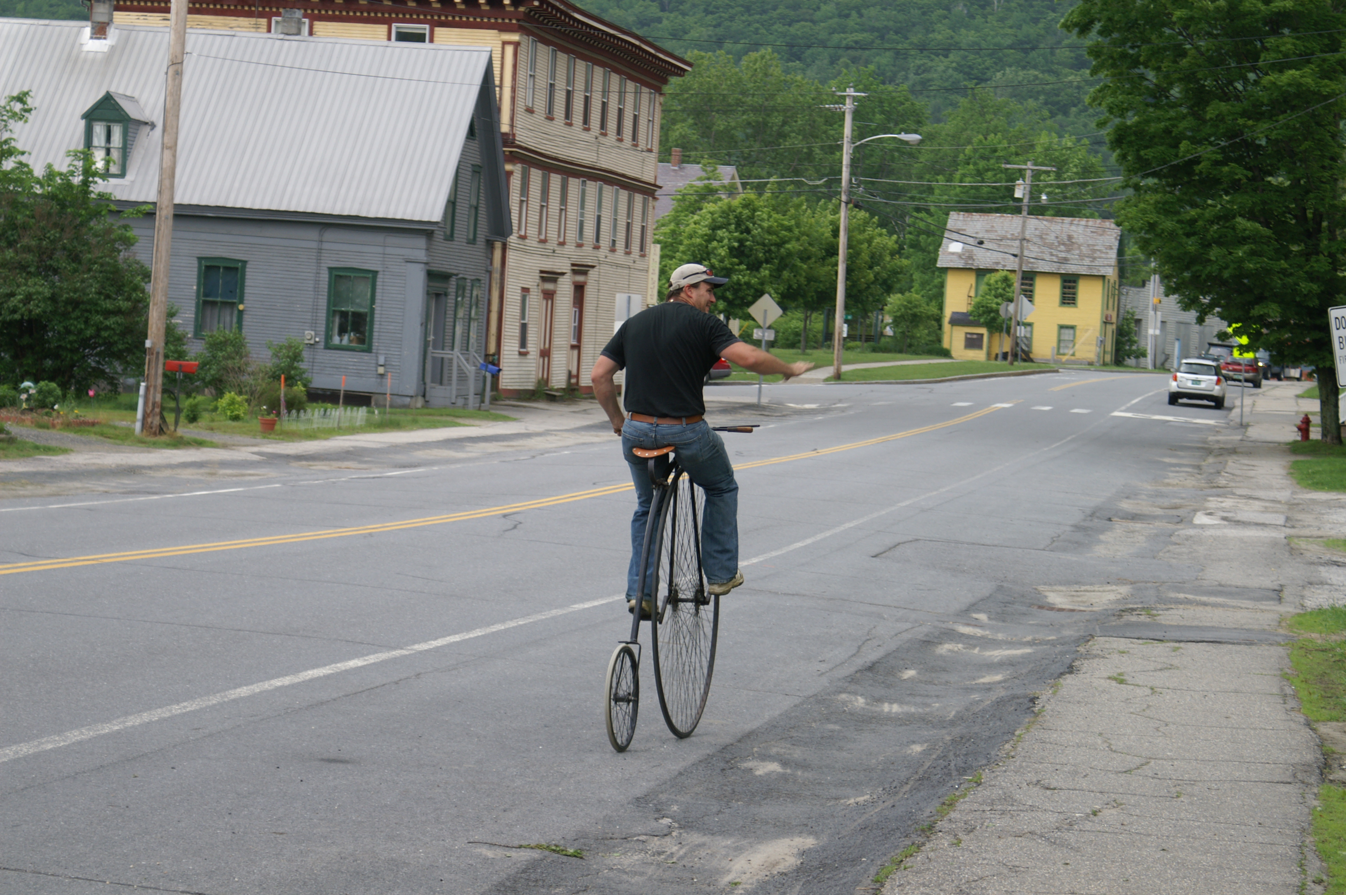
Agenda
Introductions
Purpose
Planning and Zoning Basics
Local Development Review
What to look for in plans for walking and biking
Questions and Answers
Evaluations
Photo by Rich Svec
2

Slide 3
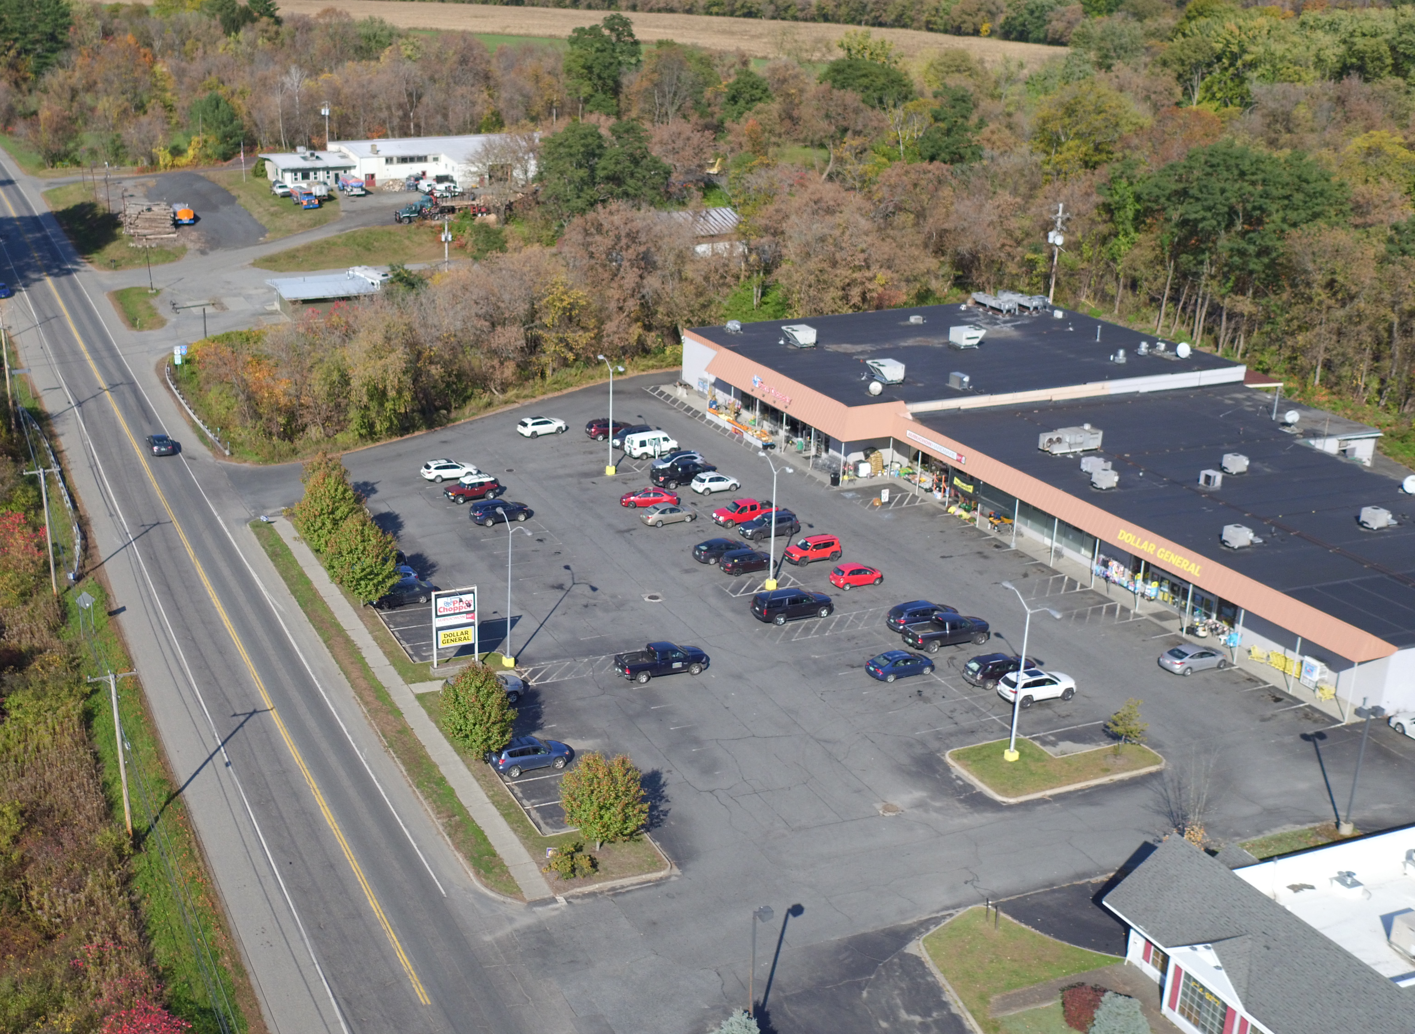
Purpose
Regular annual training program (ACCD, with VTrans)
High walking/bicycling levels
Often overlooked standards
Tools to encourage local permits that further safe walking and bicycling
Photo by Braxton Freeman

Slide 4
Planning and Zoning Basics
Relevant State Planning Goals (24 V.S.A. §4302)
(1)(D) Development should be undertaken in accordance with smart growth principles as defined in subdivision 2791(13) of this title.
  Enables choice in transportation mode, development patterns that encourage pedestrian travel
(4) To provide for safe, convenient, economic, and energy efficient transportation systems that respect the integrity of the natural environment, including public transit options and paths for pedestrians and bicyclers.
(7) To make efficient use of energy, provide for the development of renewable energy resources, and reduce emissions of greenhouse gases. (A) General strategies for achieving these goals include increasing the energy efficiency of new and existing buildings; identifying areas suitable for renewable energy generation; encouraging the use and development of renewable or lower emission energy sources for electricity, heat, and transportation; and reducing transportation energy demand and single occupancy vehicle use.

Slide 5
Planning and Zoning Basics
Municipal Plan Requirements (24 V.S.A. §4382)
(2) A land use plan, which shall consist of a map and statement of present and prospective land uses, that:
  (B) Sets forth the present and prospective location, amount, intensity, and character of such land uses and the appropriate timing or sequence of land development activities in relation to the provision of necessary community facilities and service.
  (C) Identifies those areas, if any, proposed for designation under chapter 76A of this title, together with, for each area proposed for designation, an explanation of how the designation would further the plan's goals and the goals of section 4302 of this title, and how the area meets the requirements for the type of designation to be sought.
(3) A transportation plan, consisting of a map and statement of present and prospective transportation and circulation facilities showing existing and proposed highways and streets by type and character of improvement, and where pertinent, parking facilities, transit routes, terminals, bicycle paths and trails, scenic roads, airports, railroads, and port facilities, and other similar facilities or uses, with indications of priority of need.

Slide 6
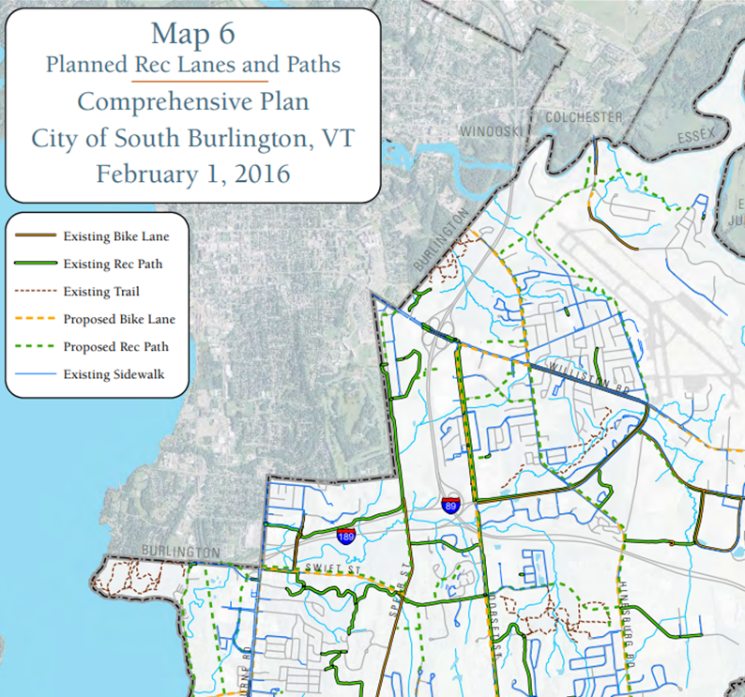
http://cms6.revize.com/revize/southburlington/document_center/planning/SB_Comprehensive_Plan_Complete_Adopted_2-1-2016.pdf

Slide 7
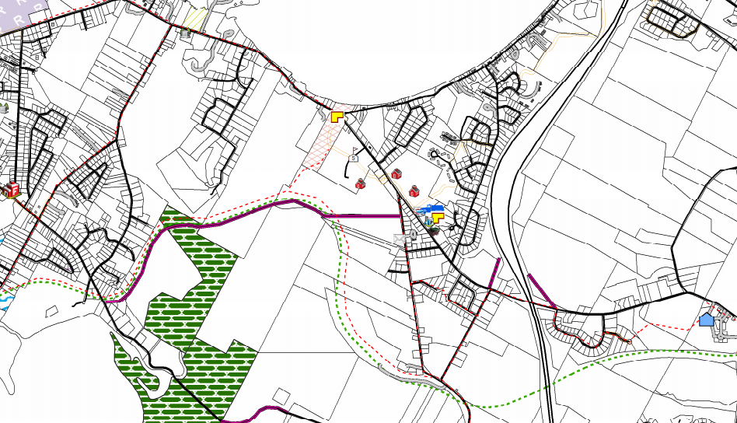
Planning and Zoning Basics
Non-regulatory Implementation (24 V.S.A. §4403)
Capital budget and program
Tax increment financing
Plans supporting the municipal plan
Official map (24 V.S.A. §4421)
https://colchestervt.gov/DocumentCenter/View/98/Official-Map-PDF?bidId=

Slide 8
Planning and Zoning Basics
Land Use Bylaws to Implement Municipal Plan (24 V.S.A. §4410)
In conformance with the plan; and,
Adopted for the purposes set forth in State Planning Goals

Slide 9
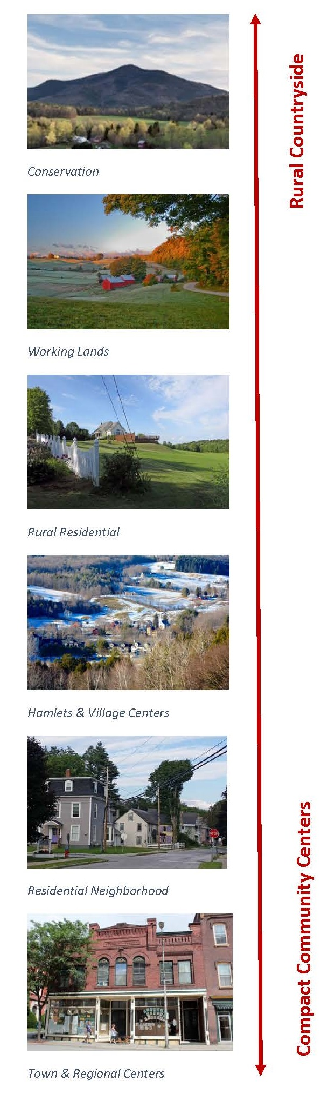
Local Development Review
Dimensional and district standards (24 V.S.A. §4414(1))
Dense, village areas: encourage walking, create a pleasant pedestrian environment, provide bicycle lanes/parking,
Along busy roads in rural districts: think about biking when appropriate
In rural districts along very low volume roads: shared road facilities are probably OK

Slide 10
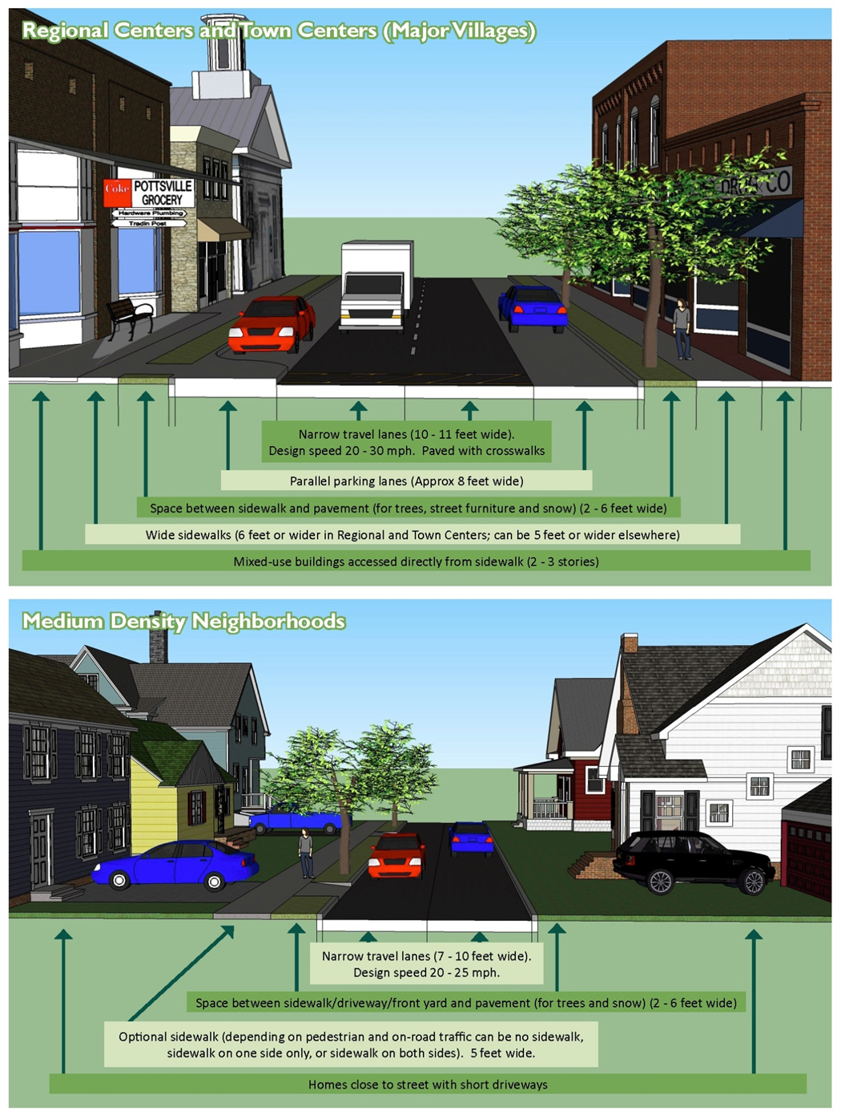
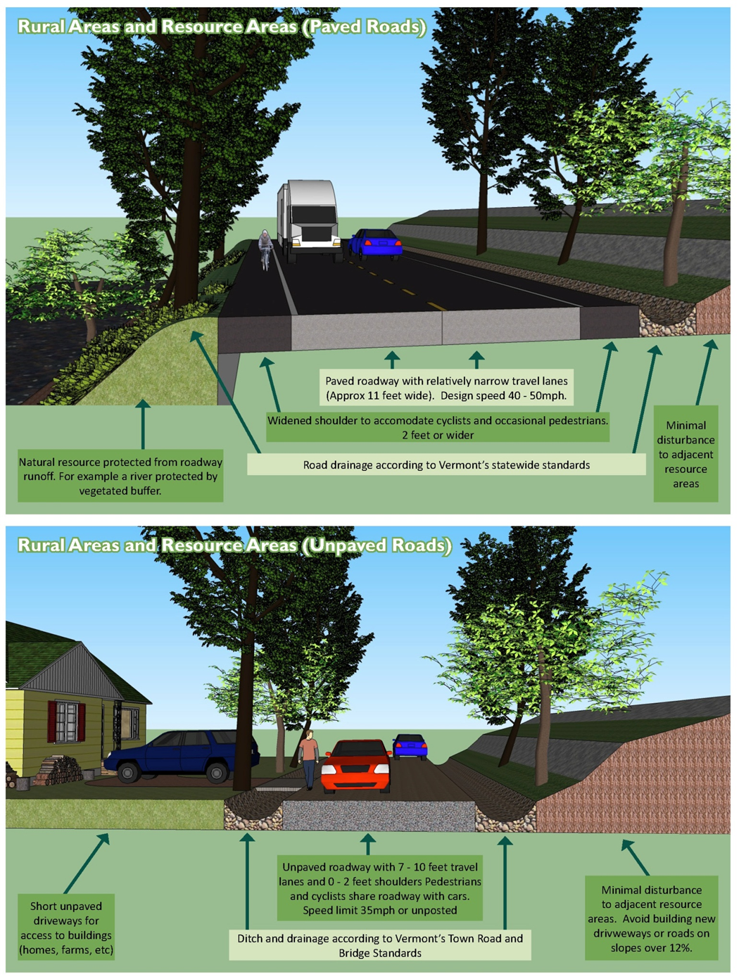
Source: Southern Windsor Country Regional Transportation Plan

Slide 11
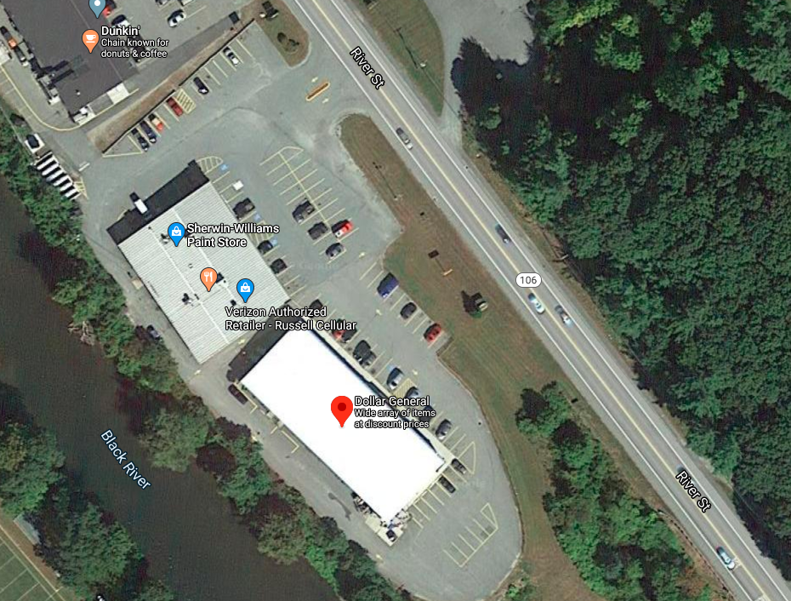
Local Development Review
Site Plan Review Standards(24 V.S.A. §4416)
Adequacy of parking, traffic access, and circulation for pedestrians and vehicles
Landscaping and screening
Exterior lighting
Other matters specified in the bylaws
Source: Google Maps

Slide 12
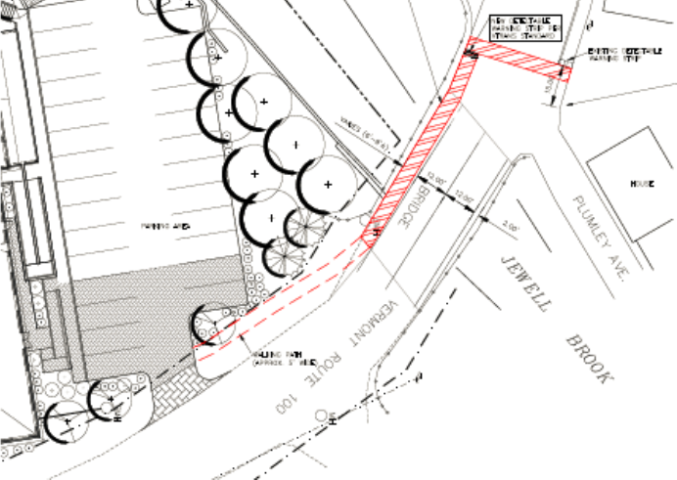
Local Development Review
Conditional Use Review Standards(24 V.S.A. §4414(3))
Shall not result in an undue adverse effect on:
  Capacity of existing or planned community facilities.
  Character of the area affected
  Traffic on roads and highways in the vicinity
Optional:
  Site plan review criteria
  Other standards and factors that the bylaws may include
  One or more of Act 250 review criteria (10 V.S.A. § 6086)
Act 250 Green Mountain Lodge #2S1253-2

Slide 13
Hartford Example

Slide 14
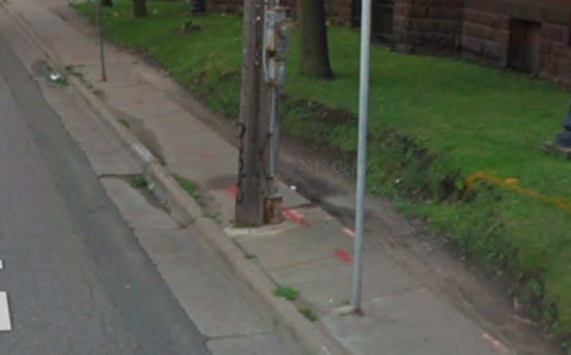
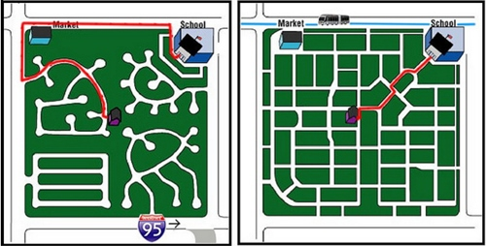
Local Development Review
Subdivision Review Standards (24 V.S.A. §4418)
Design and layout of streets, sidewalks, streetlights, landscaping, water, sewage and stormwater management facilities, public and private utilities, and other necessary improvements
Design and configuration of parcel boundaries and location of associated improvements necessary to implement the municipal plan and achieve the desired settlement pattern for the neighborhood, area, or district in which the subdivision is located
Source: Utah Street Connectivity Study
https://streets.mn/2018/04/17/does-ada-even-apply-to-sidewalks/

Slide 15
Resources
Bicycle and pedestrian planning and design
Small Town and Rural Multimodal Networks (FHWA) – Simple solutions to create better walking and biking conditions, especially in small towns and rural areas
Achieving Multimodal Networks (FHWA) – Planning for bicycling and walking
Complete Streets/Healthy Community Design (VT Dept. of Health) – Vermont developed guide to making roads that work for all users
National Association of City Transportation Officials (NACTO) – Variety of guides on urban design
Pedestrian and Bicycle Information Center (PBIC) – Site with a wide range of info on bicycle and pedestrian planning and design
Institute of Transportation Engineers (ITE) guidance on Complete Streets
ADA Checklist and Fact Sheets
ADA Checklist for Readily Achievable Barrier Removal
U.S. Access Board
U.S. Access Board Public Rights of Way Guidelines

Slide 16
Resources (cont.)
General Development Review Information
Development Review Training Modules from the Vermont Land Use Education and Training Collaborative:
  Interpreting and Applying Development Standards
  Taking Evidence
  Reading Subdivision Plats and Site Plans
  Alternative Dispute Resolution: Why, When and How
Templates for Development Review (e.g. Conditional Use, Subdivision Review), Vermont Land Use Education and Training Collaborative
VTrans Development Review Services Website
VTrans Traffic Impact Study Guidelines
Promoting Sustainable Transportation through Site Design (ITE)

Slide 17
Contacts
Jason Rasmussen
Director of Planning
Southern Windsor County Regional Planning Commission
PO Box 320
Ascutney, VT 05030
Phone: 802.674.9201
Email: jrasmussen@swcrpc.org
Jon Kaplan
Bicycle and Pedestrian Program Manager
Municipal Assistance Bureau, Highway Division
Vermont Agency of Transportation
Phone: 802-498-4742
Email: jon.kaplan@vermont.gov

