Slide 1
Weathersfield Local Hazard Mitigation Planning
Thursday May 25th
6:30pm at the 1879 Schoolhouse

Slide 3
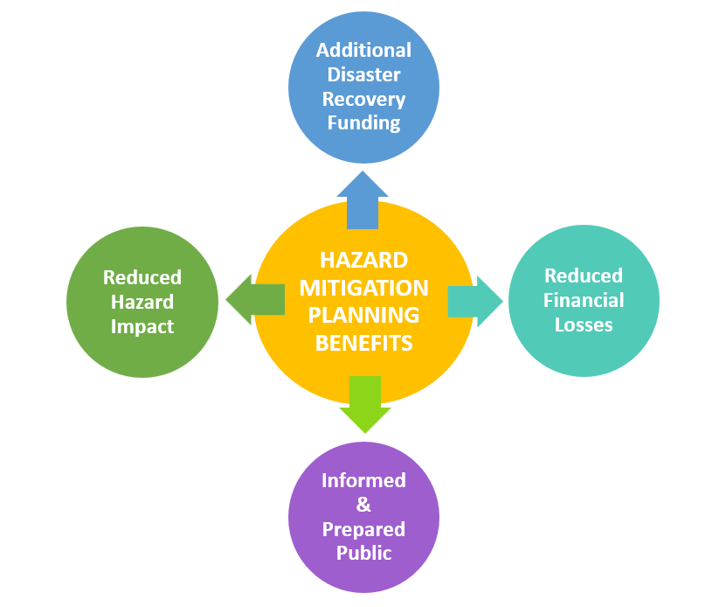

Slide 4
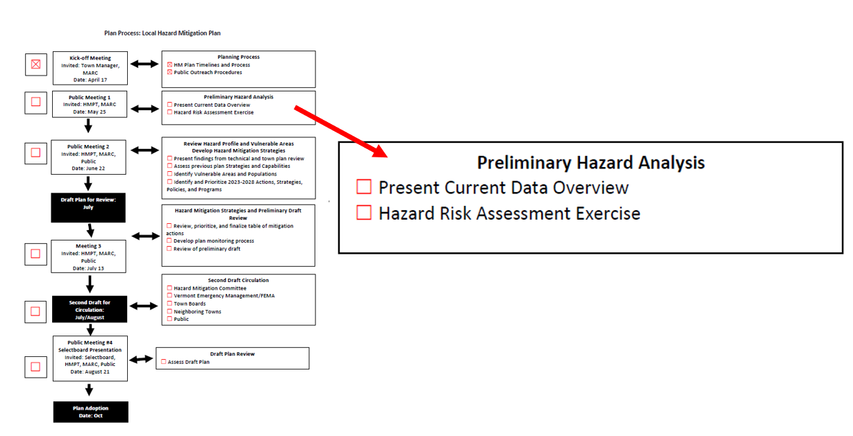

Slide 5
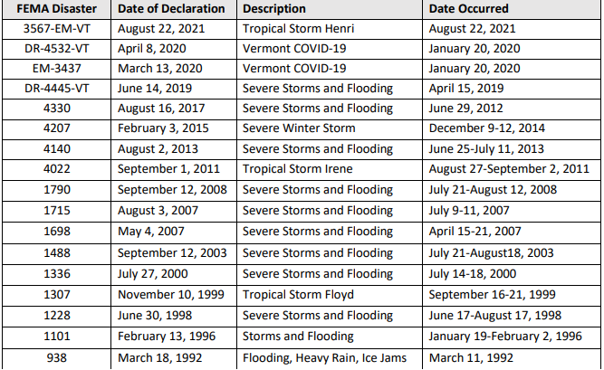
FEMA Declared Disasters-Windsor County 1970 to Current

Slide 6
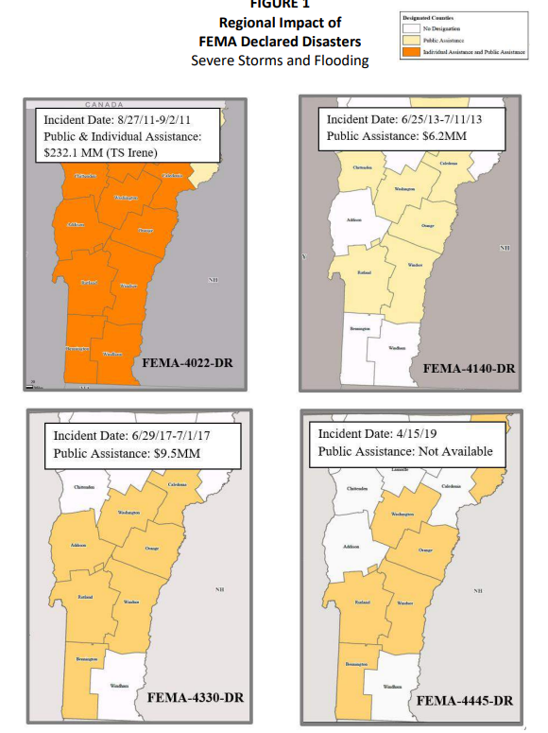

Slide 7
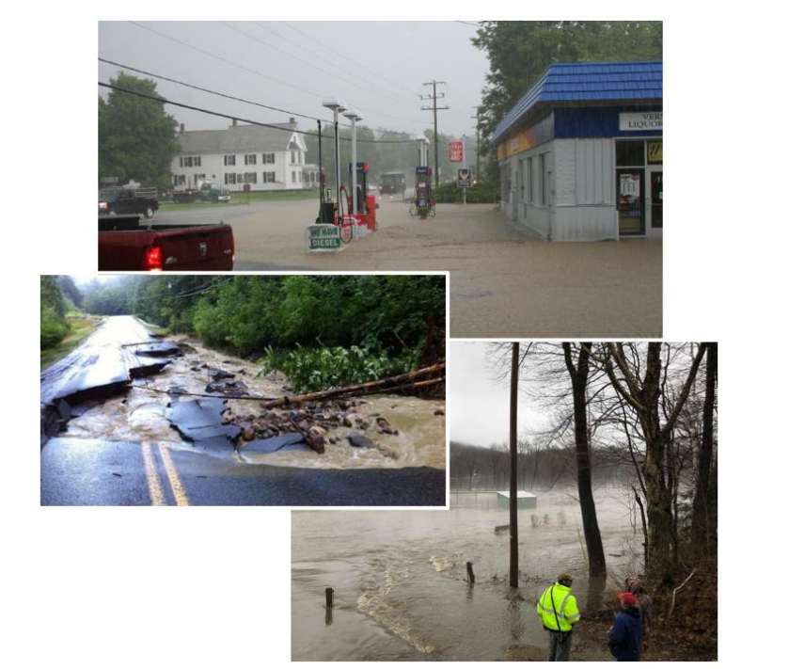

Slide 8
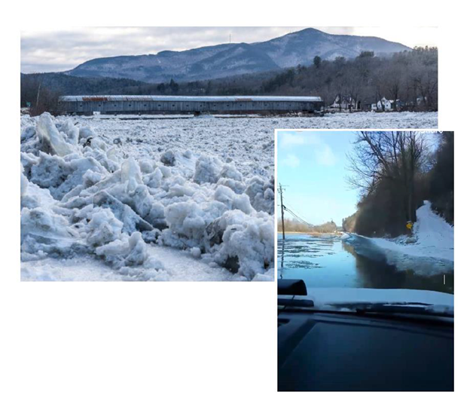

Slide 9
Local Rain Events
In July 2013, two to three inches of rain fell in two hours over eastern Windsor County. This followed a record spring rainfall and resulted in flash flooding (Estimated damage: $25k).
In July 2014, a stationary thunderstorm developed that dropped three inches of rain an hour resulted in significant damage to transportation infrastructure, residential and commercial properties, and agricultural areas (Estimated damage: $1M).
In April 2019, the towns of Ludlow and Cavendish endured a flooding event from heavy rain (Estimated damage: $100K).

Slide 10
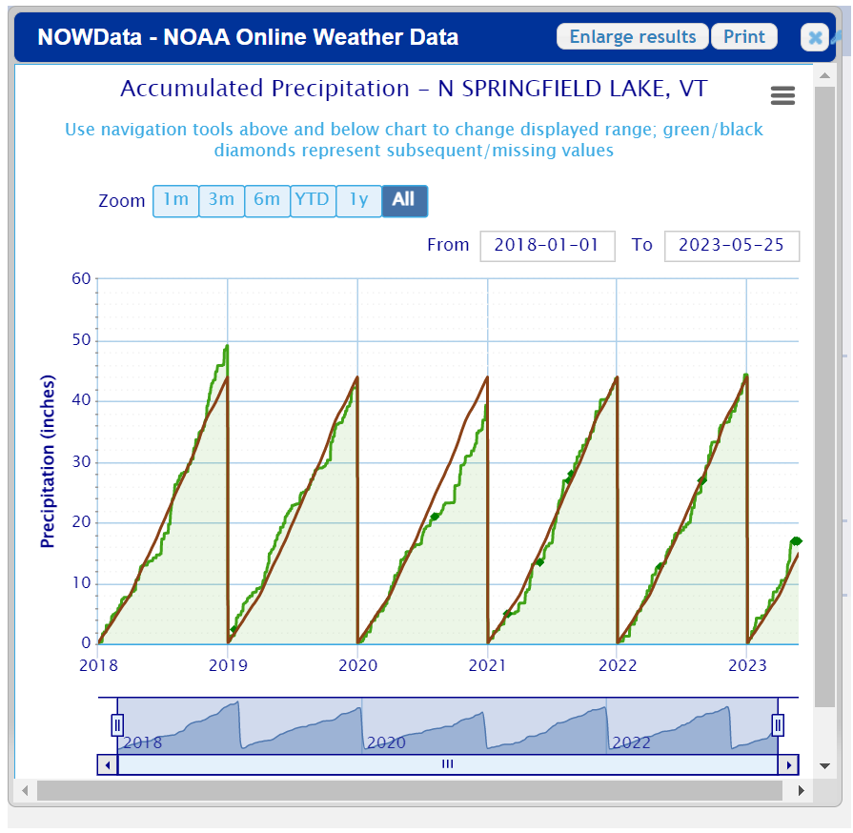

Slide 11
Fluvial erosion
Tropical Storm Irene:
The total road and bridge damage sustained by the Town of Weathersfield is estimated at over half a million dollars.
Numerous culverts required either replacement or repair
Significant damage occurred to Routes 131 and 106 in both Weathersfield and Cavendish during Tropical Storm Irene.
During Tropical Storm Irene, the North Branch caused substantial damage at the bridge on Ascutney Basin Road and Branch Brook caused significant damage to Branch Brook Road and VT Route 131.

Slide 12
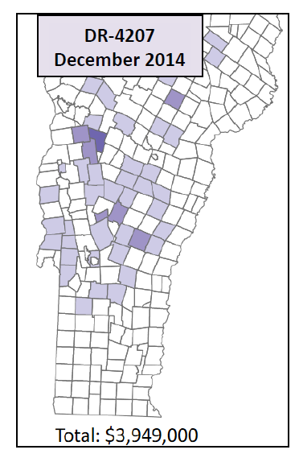
Ice Storm
DR-4207 occurred over a four-day period in mid-December 2014 when heavy, wet snow and ice resulted in more than 175,000 power outages in Windsor County.

Slide 13
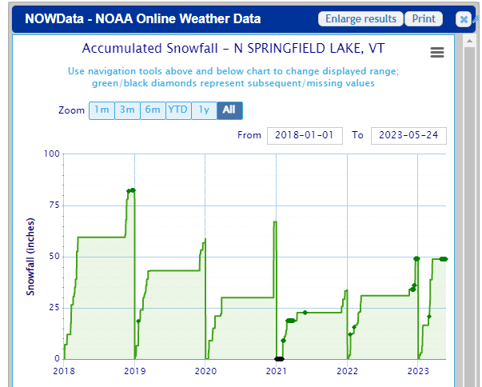
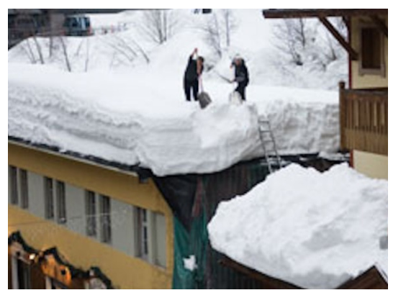
Snow
Trend:
Less snowfall each year

Slide 14
Total Snowfall (2018-2023)
Jan 10, 2019: 7 inches
Jan 20, 2019: 11 inches
Jan 29, 2019: 6 inches
Jan 19, 2020: 6 inches
Dec 17, 2020: 32 inches
Feb 2, 2021: 8 inches
April 16, 2021: 7 inches
Dec 19, 2021: 7 inches
Jan 17, 2022: 9 inches
Feb 5, 2022: 6 inches
Feb 26, 2022: 7 inches
Dec 17, 2022: 24 inches
Jan 23, 2023: 8 inches
Mar 4, 2023: 10 inches
Mar 16, 2023: 9 inches
Notes:
https://www.weather.gov/btv/snowMapArchive

Slide 15
High Winds
High winds during this April storm resulted in many trees down and damage to some private homes and public infrastructure, primarily in Southern Vermont. The Town of Windsor received assistance for this declaration.

Slide 16
Extreme Cold
January 14-15, 2022
Dangerously cold wind chills of 25 to 35 below zero were observed across the region with actual air temperatures of 10 to 15 below zero Friday evening through midday Saturday.
Overnight minimum temperatures Saturday night-Sunday morning were 10 to 20 below zero with calm/light winds.
January 7-8, 2015
Temperatures by early evening of January 7th were zero to 10 above zero with winds of 15 to 30 mph that created wind chills colder than 20 to 30 below zero through the overnight into the morning hours of January 8th.
Actual morning low temperatures on January 8th were 10 below to 20 below zero in Windsor county
January 2009: 29 below in Windsor County
March 2007: 17 below in Windsor County
January 2007: 11 below in Windsor County
Notes:
https://www.ncdc.noaa.gov/stormevents/eventdetails.jsp?id=992635

Slide 17
Extreme Heat
July 2018 – Heat wave between June 30th and July 5th
High temperatures exceeded 90 degrees for at least 5 of the six days
In many locations, temperatures were above 85 degrees for 7 days.
Increased hospitalization visits, 4 deaths (regionally)
June 2020 – Heat wave between June 18th and June 23rd
High temperatures exceeded 90 degrees for up to 6 consecutive days

Slide 19
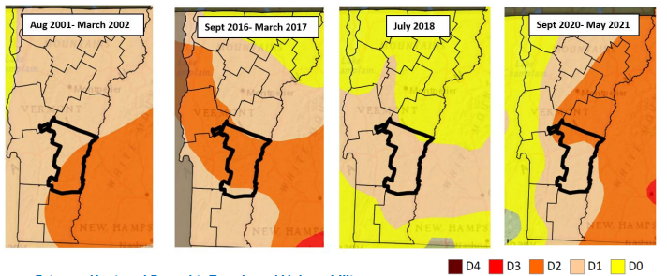
Drought
Since 2000, there have been four distinct periods of Severe to Moderate Drought in Vermont.

Slide 20
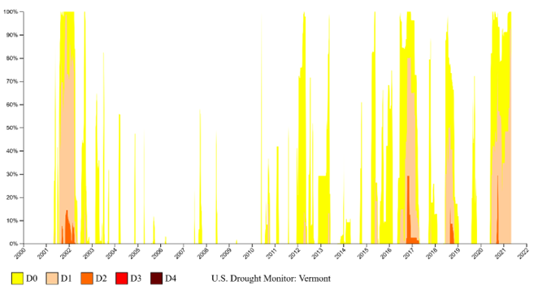
Statewide Drought Trends
Percent of State

Slide 21
Fires

Slide 22
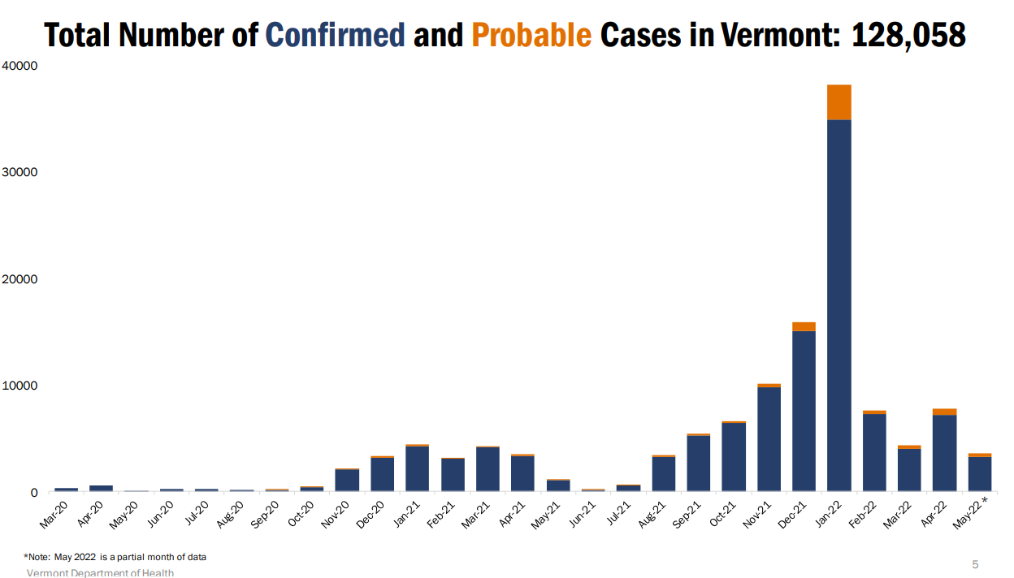
Infectious Disease
COVID cases are decreasing statewide
85% of Vermonters are fully vaccinated
64 cases in Weathersfield from March 2020 to Sept 2021

Slide 23
Hazard Events Assessment

Slide 24
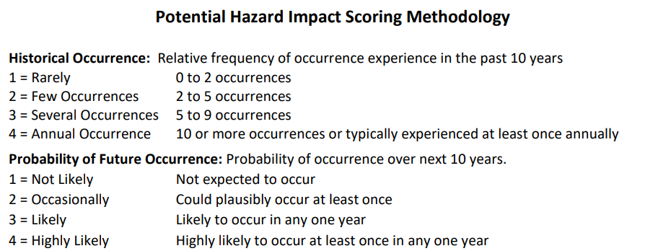

Slide 25
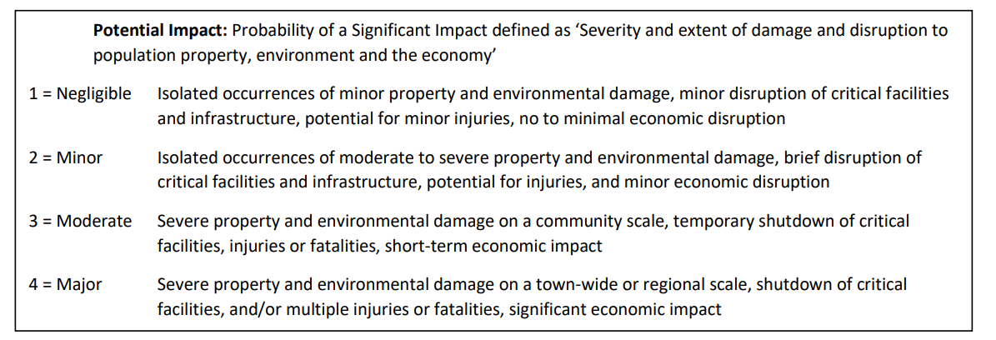

Slide 26
Hazard Impacts | Historical Occurrence | Probability of Future Occurrence | Potential Impact |  |  |  |  | Score
 |  |  | Infrastructure | Life | Economy | Environment | Average
Fluvial Erosion
Inundation Flooding
Ice
Snow
Wind
Extreme Heat
Extreme Cold

Slide 27
Hazard Impacts | Historical Occurrence | Probability of Future Occurrence | Potential Impact |  |  |  |  | Score
 |  |  | Infrastructure | Life | Economy | Environment | Average
Drought
Landslides (Slope Failure)
Wildfire
Earthquake
Invasive Species
Infectious Disease Outbreak
Hail

