Slide 1
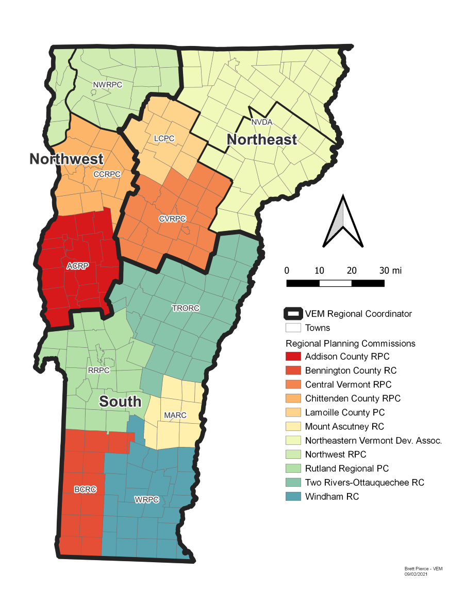
Regional Emergency Management Committees
Mount Ascutney Regional Commission
October 24th, 2022

Slide 2
Introductions
Name
Town/EM Department/Volunteer Position
Title/Role

Slide 3
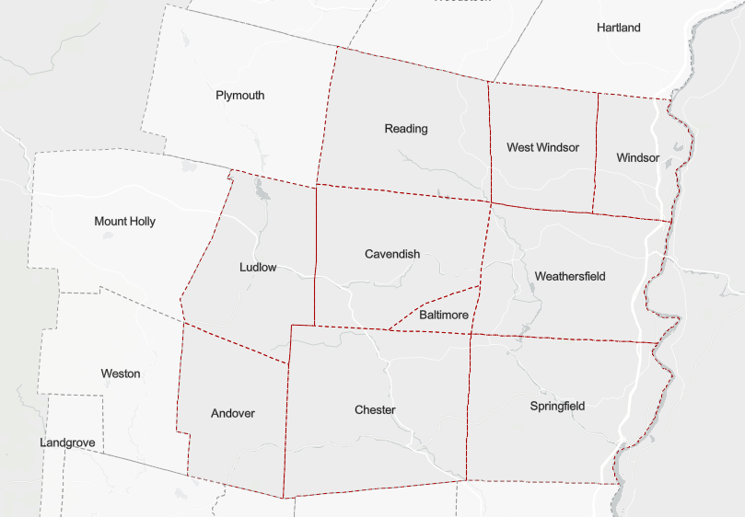
What do REMCs do?
In 2021: LEPCs → REMCs
One Statewide LEPC
Purpose:
REMCs “shall coordinate emergency planning and preparedness activities to improve their regions’ ability to prepare for, respond to, and recover from all disasters.”

Slide 4
Who is in the REMC?
Voting Members
2 appointees per Town (EMD/C + EMS representative)
Non-Voting Members
Representatives from fire departments, EMS, law enforcement, transportation, hospitals……any interested individual/organization
MARC
Administrative support and facilitation
No limit to participation!

Slide 5
Vermont Emergency Management (VEM)
Technical Assistance
Plan Development Workshops
Trainings & Exercises
Taiga Christie
Southern Regional Coordinator
Taiga.Christie@vermont.gov
Notes:
Hand over to Taiga..

Slide 6
Mutual Aid Agreements
Notes:
Taiga

Slide 7
LaGuardia Airport Traffic Control, 2009
Notes:
Taiga

Slide 8
Group Discussion
Does your town have mutual aid agreements in place?
What type of mutual aid agreements would be useful to your Town?
What kinds of assistance would your Town benefit from?

Slide 9
Tabletop Exercises
Notes:
Taiga

Slide 10
Group Discussion
What types of emergency plans does your Town have?
Which emergency plans would you like to exercise?
Examples: Long term power outage, hot weather emergency, Cybersecurity
CatEx4 / Binary Blizzard

Slide 11
Future Presentations & Discussions
Available presentations:
National Weather Service
National Guard
Local Shelter Initiatives
Regionalization
Shelter and LEMP/EOC TTXs

Slide 12
Next Meeting: January 2024
Contact mcordero@marcvt.org to be added to our Emergency Management email list

